Slide 1



Culture Deck
2026

Slide 2
Disclaimers
The material in this culture deck is not “right” or “wrong.” Rather, it is a subjective interpretation of Ecopulz and our company culture in their current state of existence.
Culture is dynamic and ever-changing. This material reflects the current state of things within Ecopulz, as well as our current visions for the future. However, these may change at a later point in time.

Slide 3
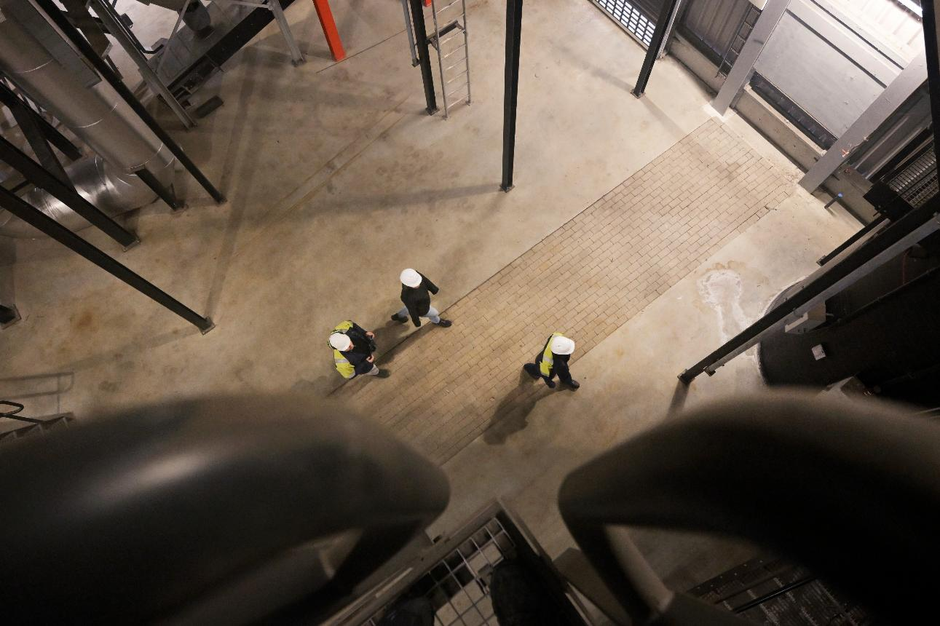
Overview
About culture
Our company history
Introduction to Ecopulz
Our core values
What we do
Our people and culture

Slide 4
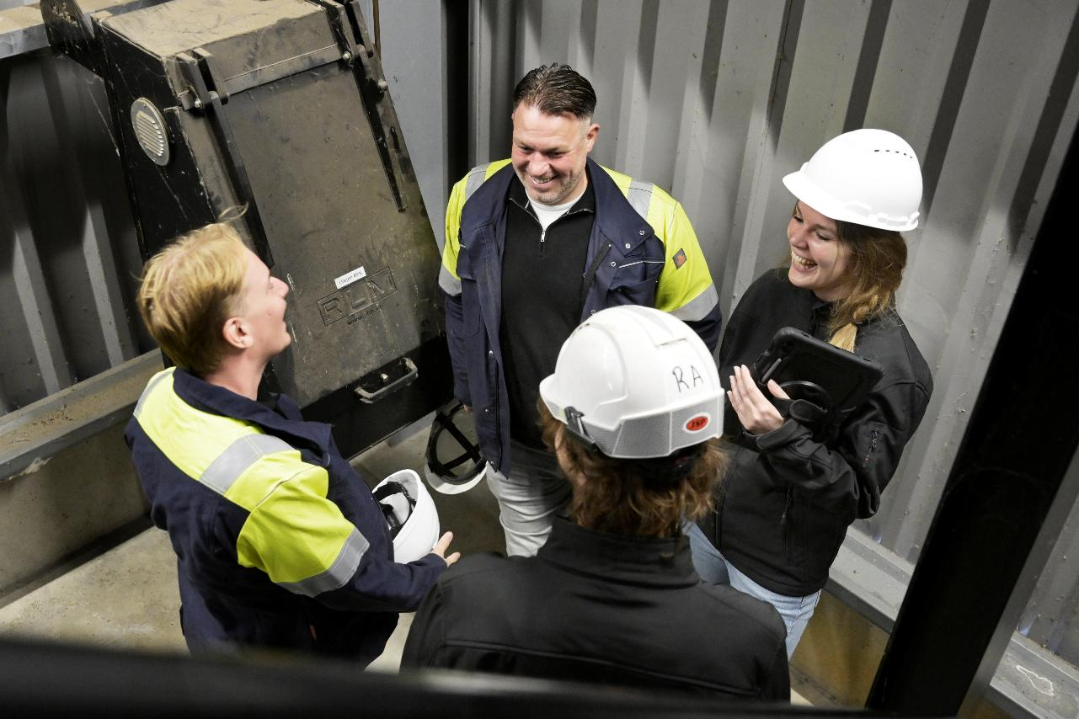
About culture

Slide 5
Defining culture
Culture is:
Those everyday acts we take for granted as “normal” and often do not pay special attention to.
A group of people repeating behaviors.
Shared beliefs, practices, norms, customs, traditions, symbols, language and/or values.
Notes:
Defining culture helps us determine our core values. Our values are created in an interplay of intention and already existing culture. By understanding what culture is, we therefore gain a deeper understanding of what values are and how they have come into existence.

Slide 6
What is company culture?
Company culture refers to the shared values, beliefs, behaviors, etc. that characterize a company and shape the way its employees interact, make decisions, and approach their work.
Company culture influences everything from how people communicate and collaborate to how the company makes strategic decisions and treats its clients.

Slide 7
Why cultural analysis?
Through cultural analysis, we can clearly define our company culture.
The company culture exists independently from the cultural analysis. But by becoming aware of what the company culture is, we can get to know ourselves better as a company.
Through this knowledge, it is easier to develop strategies for growth, as well as attract new clients, partners and employees.

Slide 8
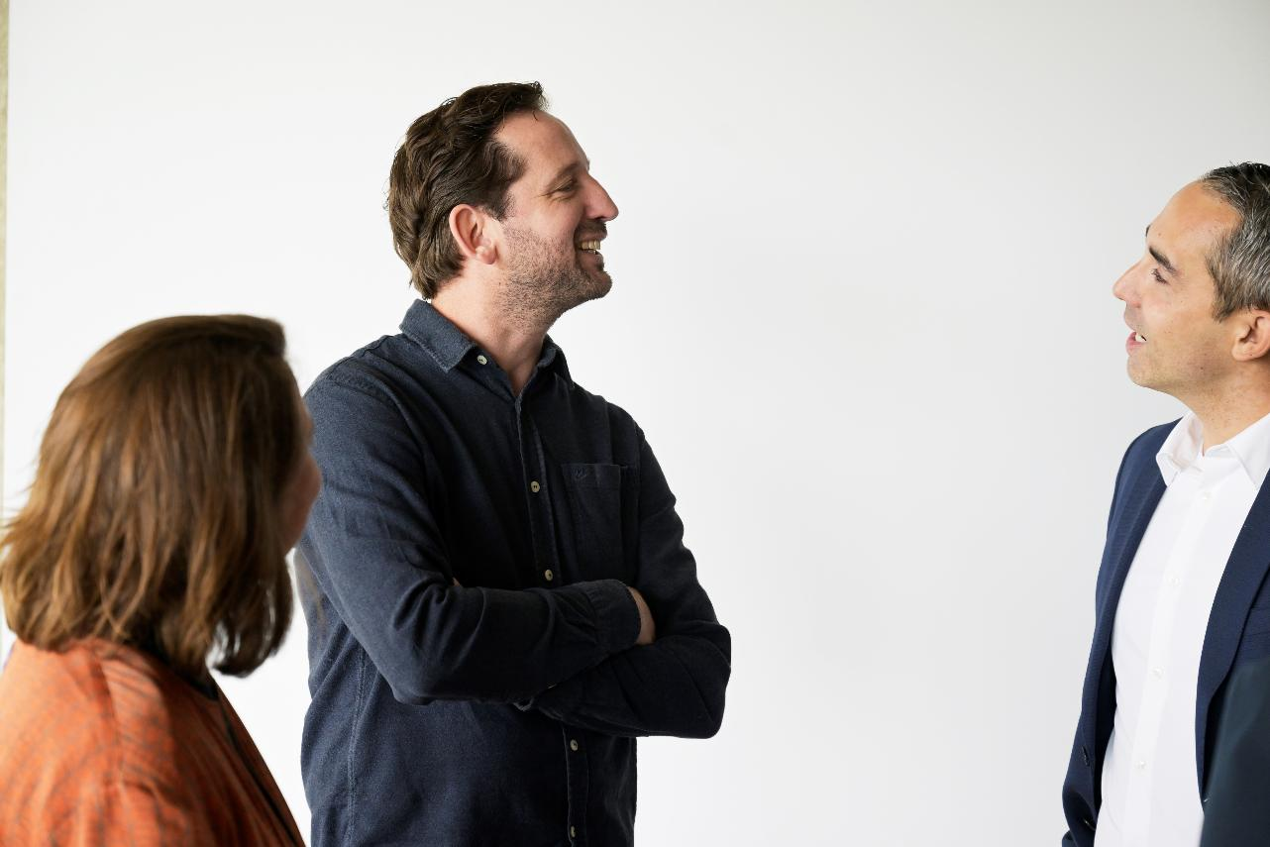
Our company history

Slide 9
Company history
The origin of 1406
Over the years, Olaf and Ramon met regularly while working for other companies, and their collaboration was always successful. Olaf increasingly thought about starting his own company, especially when his job at the time no longer felt like the right fit. Given their positive experiences, Olaf and Ramon decided to pursue this idea together.
As a result, Ecopulz was founded in 2019 by Olaf and Ramon under the name 1406.
In 2023, Niels became co-owner of 1406.

Slide 10
Company history
Sports mentality
The name 1406 originates from triathlon. Both Olaf and Ramon are passionate about sports and decided to name their company after the total distance of the longest triathlon, which is 140.6 miles.
While most current Ecopulz employees have never participated in a triathlon, the company culture is originally rooted in a sports mentality.
This sports mentality entails 1) a passion for reaching goals, 2) discipline, and 3) the ability to turn setbacks into something positive.

Slide 11
Company history
From 1406 to Ecopulz
Since 2023, our company has adopted a new brand name and identity, as well as developed an entirely new vision of our role in the world. This transformation represented a shift in our identity, values and goals.
The transition from 1406 to Ecopulz marks an important turning point in our company’s journey. The new name reflects a renewed commitment to sustainability and a desire to make a positive impact. It is a name that not only honors our past but also anchors our future in advancing sustainability.

Slide 12
Company history
A new mission
At Ecopulz, we have chosen to capture our mission in the powerful tagline: Enablers of Sustainability. This tagline is more than just a slogan – it is a promise to ourselves and to the world. It expresses what we do, what we stand for, and why we work diligently every day.
This new identity and mission are the pillars on which we are building our future at Ecopulz. They are the foundation for our Enabler's Mindset, a philosophy that drives our employees and sets us apart as an organization.

Slide 13
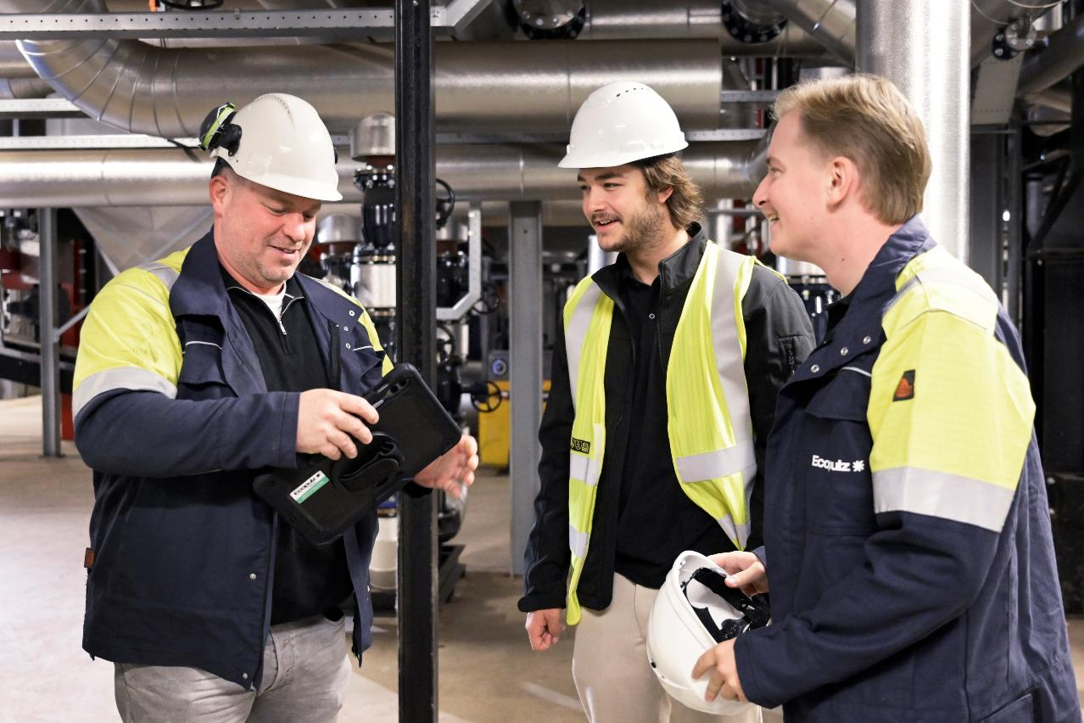
Introduction to Ecopulz

Slide 14
The Enabler’s Mindset
At Ecopulz, the Enabler’s Mindset means helping others reach their full potential while creating positive, lasting impact. It’s about turning obstacles into opportunities, sharing knowledge, and fostering collaboration so that both people and organizations can thrive. Enablers are self-aware, appreciate the strengths of others, and know when to lead or step back to support the team.
We bring this mindset into all our work, from asset management to driving energy transitions. By optimizing resources, removing barriers, and enabling people, we strengthen organizational processes and create practical, sustainable change. In everything we do, the Enabler’s Mindset guides us to grow, innovate, and build a more resilient, sustainable future.

Slide 15
Our hiring process
As part of our hiring process, all potential employees are asked to take the following tests:
  The Enneagram Personality Test
  The CliftonStrengths Assessment
These tests help us understand each candidate’s strengths, traits, and qualities. This insight allows us to see how potential team members might fit into our team, and to identify the tasks and assignments that best align with their skills. Ultimately, this approach helps us build a more effective, diverse, and harmonious team.
At Ecopulz, there is an interest in getting to know each other as people - what we are good at, what we like, what is important to us, etc.

Slide 16




The three pillars in our work
Enabling people – to become enabler’s of sustainability
Enabling assets – to be efficient and consistent
Enabling organizations – to be resilient and competitive

Slide 17

Enabling People
At Ecopulz, our focus goes beyond completing projects – we aim to create lasting impact on people.
We believe true progress happens when individuals grow and unleash their full potential. In today’s rapidly changing world, your people are your greatest asset, and by investing in their knowledge, skills, and mindset, they don’t just meet expectations – they exceed them.
Partnering with Ecopulz fosters a culture of continuous learning and development, where people thrive, organizations excel, and the impact endures long after the work is done.

Slide 18

Enabling Assets
At Ecopulz, enabling assets means going beyond routine maintenance of district heating networks and sustainable installations. We combine technical analysis, monitoring, and practical expertise to manage assets that perform better and last longer.
By identifying key risks and opportunities, and structuring processes for full operational and financial control, we enhance reliability and reduce total cost of ownership – building smartly on what already exists.

Slide 19

Enabling Organizations
In the energy transition, organizations operate in a complex and fast-changing environment. Agility, clear processes, and well-structured contractual arrangements are essential to stay on course and make a real impact.
Ecopulz supports your organization through interim management, contract management, and process optimization, providing clarity, strengthening execution, and ensuring your organization is fully prepared for what lies ahead.

Slide 20
Mission and vision
At Ecopulz, our mission is to create sustainable impact by empowering the people, assets, and organizations driving the energy transition. With our Enabler’s Mindset, we unlock the potential of individuals and systems, fostering innovation and collaboration.
At Ecopulz, we envision a world where empowered people, optimized assets, and sustainable organizations work together to drive the energy transition. We strive to be the catalyst for positive change and to help shape a world where sustainability is at the heart of every decision.

Slide 21
What is Ecopulz?
Open-minded
Open to new ideas
Innovative
Good at creating opportunities
Ambitious
Dynamic
Flexible
Growing (internationally)
Dutch
Multicultural
A company that provides services in the energy and utilities sector
Rooted in the Netherlands and the Dutch heating transition
Active in the Netherlands, Egypt, and Spain
Experienced project managers
Young talent
Active in asset management and education
Business casual
A flat company structure
A Dutch team spread out across the Netherlands
A company with offices in Breda, Cairo and Spain
Type 3 enneagram
Entrepreneurship

Slide 22
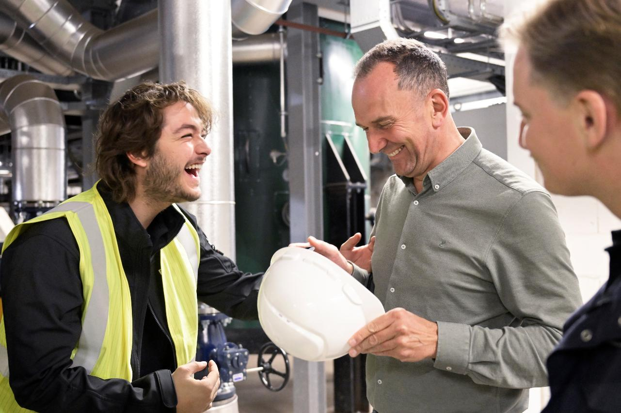
Our core values

Slide 23


Sustainability
Enabling
Development
Collaboration
Ownership

Slide 24
Sustainability
Sustainability at Ecopulz means maximizing and improving assets to drive the energy transition, promoting a positive impact on the environment and society, and building a thriving company culture where leadership fosters success, learning and continuous improvement.

Slide 25
Enabling
Enabling at Ecopulz means empowering people, organizations and projects by unlocking their potential, encouraging growth and facilitating success - whether through coaching, training programs or leveraging unique talents to create meaningful change.

Slide 26
Development
At Ecopulz, development means continually advancing innovative technologies and business practices as well as encouraging personal and professional growth through lifelong learning. This all with a view to driving the energy transition and achieving sustainable goals.

Slide 27
Collaboration
Collaboration at Ecopulz means fostering open communication, trust and equality within a diverse team, while building strong partnerships locally and internationally and empowering everyone to contribute meaningfully and influence decisions for shared success.

Slide 28
Ownership
At Ecopulz, ownership means fostering a corporate culture of initiative, responsibility and dedication, where individuals and our team take responsibility for their work, embrace autonomy and turn challenges into opportunities for long-term growth and success.

Slide 29
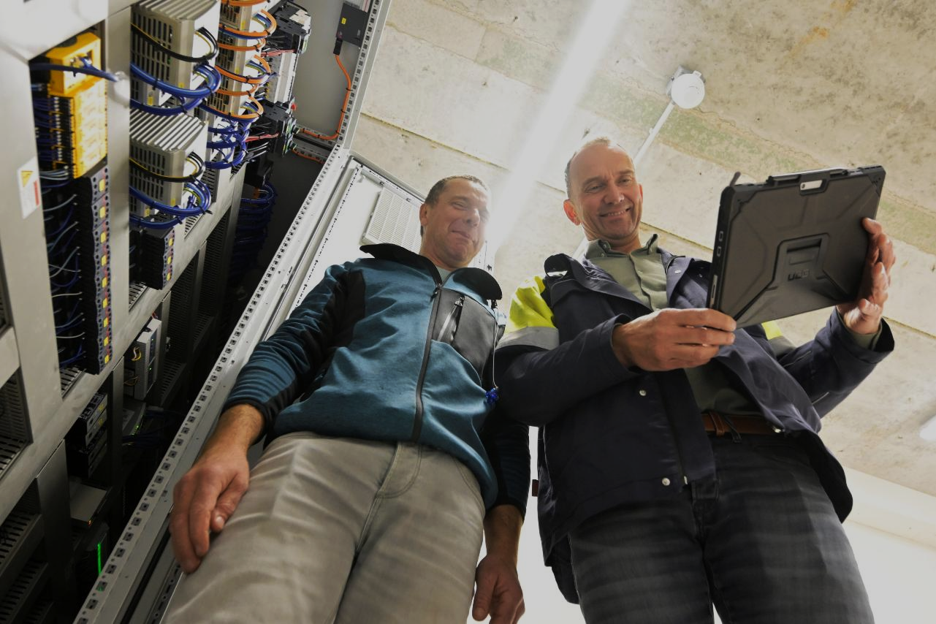
What we do

Slide 30
What we do
Asset management expertise
Active in the Dutch heating transition
Expanding internationally in sustainable energy

Slide 31
Asset management expertise
At Ecopulz, we are:
  Backed by seasoned asset managers with deep, hands-on industry experience.
  Focused on data-driven decisions across the full asset lifecycle.
  Committed to maximizing performance, compliance, and long-term value.
Altima – our proprietary asset management platform:
  Centralizes asset data, maintenance, and performance insights in one platform;
  Drives proactive, data-driven asset and lifecycle decisions;
  Improves reliability, cost control, and compliance across operations.

Slide 32
Active in the Dutch heating transition
At Ecopulz we are:
Working closely with clients and local partners to deliver sustainable heating solutions across the Netherlands;
Applying our asset management expertise to support the transition from gas to future-proof heating infrastructure;
Actively contributing knowledge and experience to the evolving Dutch energy system and societal transition.

Slide 33
Expanding internationally in sustainable energy
Over the past years, we’ve grown our presence in global sustainable energy markets.
Completed our first project in Egypt: developing a TVET curriculum on green hydrogen, sustainability, and intercultural exchange.
Empowering local communities to actively participate in the energy transition and build lasting skills for a sustainable future.

Slide 34

Our people and culture

Slide 35
Our people and culture
Our diverse team brings together professionals from a wide range of cultural and professional backgrounds, combining local insight with global experience.
We blend seasoned asset managers, engineers, and sustainability experts with talented junior colleagues and team members from social and cultural fields.
Headquartered in the Netherlands, our team also includes employees in Egypt and Spain, reflecting our international reach and collaborative approach.

Slide 36
Our people and culture
Flat organizational structure:
We foster open communication and collaboration across all levels of the organization.
Every voice matters, and all ideas are welcomed – even those that challenge the status quo.
Our approach encourages agility, transparency, and shared ownership of outcomes.

Slide 37
Our people and culture
Continuous learning and development:
We prioritize ongoing education through formal training programs and hands-on, on-the-job learning.
We believe in the power of education – both for empowering our employees and for supporting vocational training initiatives in the communities we serve.
Continuous learning drives growth, innovation, and impact across everything we do.

Slide 38
Our people and culture
Our team dynamic:
We are ambitious and driven, tackling challenges with focus and dedication.
At the same time, we prioritize a friendly, open, and down-to-earth atmosphere in our team.
Everyday moments – lunch chats, coffee breaks, and spontaneous brainstorms – make our work environment lively and enjoyable.
We also prioritize company events – organized by our own event team – to bring everyone together throughout the seasons, celebrate achievements, and enjoy good food and snacks.

